Slide 1
Natural Language Processing IST 664/CIS 668
Week 9 – Recommended Reading
Jurafsky and Martin, Speech and Language Processing, 3rd edition.
Speech and Language Processing (stanford.edu)
Chapter 11 Machine Translation
Chapter 17 Information Extraction
1

Slide 2

Information Extraction:
Overview

Slide 3
Motivation for
Information Extraction
When we covered semantic analysis, we focused on:
­ The analysis of single sentences
­ A deep approach that could, in principle, be used to extract considerable information from each sentence
­ And a tight coupling with syntactic analysis
Unfortunately, when released in the wild, such approaches have difficulties with:
­ Speed: deep syntactic and semantic analysis of each sentence is too slow for many applications
­ Transaction processing where large amounts of newly encountered text has to be analyzed
­ Coverage: real-world texts tend to strain both the syntactic and semantic capabilities of most systems
Slides adapted from Jim Martin

Slide 4
Information Extraction
So, just as we can do with partial parsing and chunking for syntax, we can look for more lightweight techniques that get us most of what we might want in a more robust manner.
­ Figure out the entities (the players, props, instruments, locations, etc. in a text).
­ Figure out how they’re related.
­ Figure out what they’re all up to.
­ And do each of those tasks in a loosely coupled, data-driven manner.

Slide 5
Targeted Semantic Analysis
Ordinary newswire text is often used in typical examples.
­ Target "who,” “what,” “when,” “where” of news events
­ And there’s an argument that there are useful applications there
The real interest/money is in specialized domains.
­ Bioinformatics
­ Patent analysis
­ Specific market segments for stock analysis
­ Intelligence analysis
­ Etc.

Slide 6
Overview of Information Extraction
CHICAGO (AP): Citing high fuel prices, United Airlines said Friday it has increased fares by $6 per round trip on flights to some cities also served by lower-cost carriers. American Airlines, a unit of AMR, immediately matched the move, spokesman Tim Wagner said. United, a unit of UAL, said the increase took effect Thursday night and applies to most routes where it competes against discount carriers, such as Chicago to Dallas and Atlanta and Denver to San Francisco, Los Angeles and New York.

Slide 7
Named Entity Recognition
Find the named entities and classify them by type.
CHICAGO (AP): Citing high fuel prices, United Airlines said Friday it has increased fares by $6 per round trip on flights to some cities also served by lower-cost carriers. American Airlines, a unit of AMR, immediately matched the move, spokesman Tim Wagner said. United, a unit of UAL, said the increase took effect Thursday night and applies to most routes where it competes against discount carriers, such as Chicago to Dallas and Atlanta and Denver to San Francisco, Los Angeles and New York.

Slide 8
Relation Extraction
Basic task: Find all the classifiable relations among the named entities in a text (populate a database).
­ Employs (e.g., {<American, Tim Wagner> })
­ Part-of (e.g., {<United, UAL>, {American, AMR} >)
CHICAGO (AP): Citing high fuel prices, United Airlines said Friday it has increased fares by $6 per round trip on flights to some cities also served by lower-cost carriers. American Airlines, a unit of AMR, immediately matched the move, spokesman Tim Wagner said.
United, a unit of UAL, said the increase took effect Thursday night and applies to most routes where it competes against discount carriers, such as Chicago to Dallas and Atlanta and Denver to San Francisco, Los Angeles and New York.

Slide 9
Event Detection
Find and classify all the events of interest in a text.
­ Most verbs introduce events/states, but not all (give a kiss)
­ Nominalizations often introduce events
­ Collision, destruction, the running…
CHICAGO (AP): Citing high fuel prices, United Airlines said Friday it has increased fares by $6 per round trip on flights to some cities also served by lower-cost carriers. American Airlines, a unit of AMR, immediately matched the move, spokesman Tim Wagner said. United, a unit of UAL, said the increase took effect Thursday night and applies to most routes where it competes against discount carriers, such as Chicago to Dallas and Atlanta and Denver to San Francisco, Los Angeles and New York.

Slide 10
Temporal and
Numerical Expressions
Find all the temporal expressions.
­ Normalize them based on some reference point.
Find all the numerical expressions.
­ Classify by type and normalize.
CHICAGO (AP): Citing high fuel prices, United Airlines said Friday it has increased fares by $6 per round trip on flights to some cities also served by lower-cost carriers. American Airlines, a unit of AMR, immediately matched the move, spokesman Tim Wagner said.
United, a unit of UAL, said the increase took effect Thursday night and applies to most routes where it competes against discount carriers, such as Chicago to Dallas and Atlanta and Denver to San Francisco, Los Angeles and New York.

Slide 11
Template Analysis
Many news stories have a script-like flavor to them. They have fixed sets of expected events, entities, relations, etc.
Template, schema, or script processing involves:
­ Recognizing that a story matches a known script
­ Extracting the parts of that script
CHICAGO (AP): Citing high fuel prices, United Airlines said Friday it has increased fares by $6 per round trip on flights to some cities also served by lower-cost carriers. American Airlines, a unit of AMR, immediately matched the move, spokesman Tim Wagner said.
United, a unit of UAL, said the increase took effect Thursday night and applies to most routes where it competes against discount carriers, such as Chicago to Dallas and Atlanta and Denver to San Francisco, Los Angeles and New York.

Slide 12
Information Extraction: Named Entity Recognition
(NER)

Slide 13
Information Extraction Typical Tasks
Named entity recognition and classification Coreference analysis
Temporal and numerical expression analysis Event detection and classification
Relation extraction Template analysis

Slide 14
NER (Named Entity Recognition)
Find and classify all the named entities in a text. What is a named entity?
­ A mention of an entity using its name
­ Kansas Jayhawks
­ This is a sub-set of the possible mentions
­ Kansas, Jayhawks, the team, it, they
Find means identify the exact span of the mention.
Classify means determine the category of the entity being referred to.

Slide 15
Typical Named Entity (NE) Types for Newswire Text
Some applications add more specific types.
Type | Tag | Sample Categories
People | PER | Individuals, fictional characters, small groups
Organization | ORG | Companies, agencies, political parties, religious groups,
 |  | sports teams
Location | LOC | Physical extents, mountains, lakes, seas
Geo-Political | GPE | Countries, states, provinces, counties
Entity
Facility | FAC | Bridges, buildings, airports
Vehicles | VEH | Planes, trains, automobiles

Slide 16
Examples of NE for Newswire Text
Type | Example
People | Turing is often considered to be the father of modern computer science.
Organization | The IPCC said it is likely that future tropical cyclones will become
 | more intense.
Location | The Mt. Sanitas loop hike begins at the base of Sunshine Canyon.
Geo-Political | Palo Alto is looking at raising the fees for parking in the University
Entity | Avenue district.
Facility | Drivers were advised to consider either the Tappan Zee Bridge or the
 | Lincoln Tunnel.
Vehicles | The updated Mini Cooper retains its charm and agility.

Slide 17
Ambiguity
A common ambiguity is whether a city, state, or country is a location or a political entity.
­ Palo Alto could be either.
Name | Possible Categories
Washington | Person, Location, Political Entity, Organization, Facility
Downing St. | Location, Organization
IRA | Person, Organization, Monetary Instrument
Louis Vuitton | Person, Organization, Commercial Product
[_{PERS} Washington] was born into slavery on the farm of James Burroughs. [_{ORG} Washington] went up two games to one in the four-game series. Blair arrived in [_{LOC} Washington] for what may well be his last state visit. In June, [_{GPE} Washington] passed a primary seatbelt law. The [_{FAC} Washington] had proved to be a leaky ship, every passage I made…

Slide 18
NER Approaches
As with partial parsing and chunking, there are two basic approaches (and hybrids).
­ Rule-based (regular expressions)
­ Lists of names
­ Patterns to match things that look like names
­ Patterns to match the environments in which classes of names tend to occur
­ ML-based approaches
­ Get annotated training data
­ Extract features
­ Train systems to replicate the annotation

Slide 19
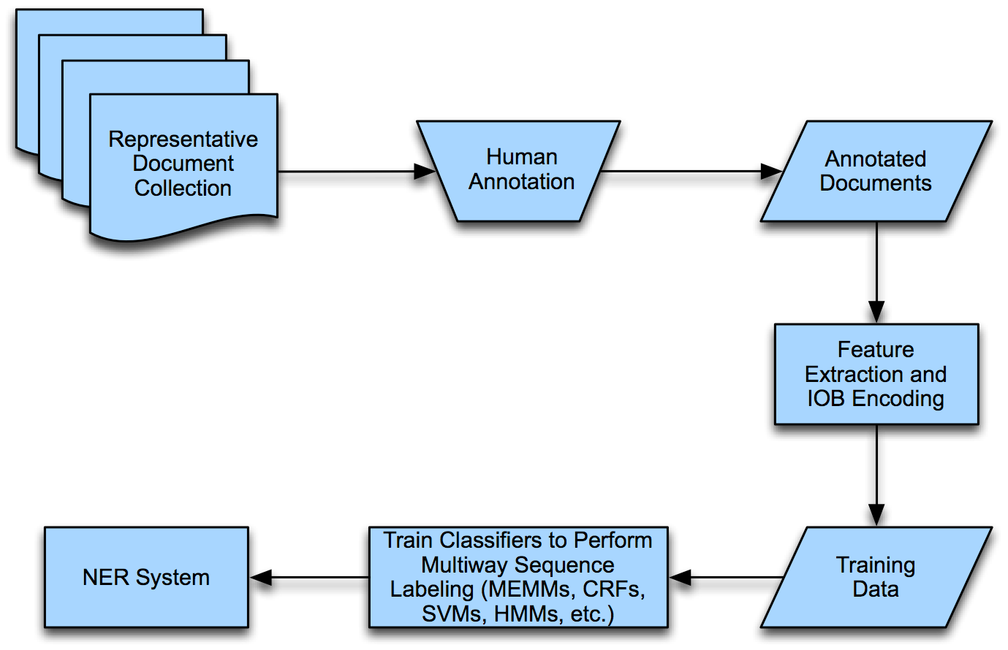
ML Approach

Slide 20
Encoding for Sequence Labeling
Named entity annotation often uses the IOB encoding.
­ For N classes (i.e., types of entities), we have 2 * N + 1 tags for tokens.
­ B of that class for a token at the beginning of an entity of that class
­ I of that class for a token inside an entity of that class
­ O for a token outside of any class
­ Each token in a text gets a tag.

Slide 21
NER Features
Features may include the word, POS tag, IOB for its phrase type, and the shape of the word.
­ Feature examples
Features Label
American | NNP | ^{B}NP | cap | ^{B}0RG
Airlines | NNPS | ^{I}NP | cap | ^{I}0RG
, | PUNC | O | punc | O
a | DT | ^{B}NP | lower | O
unit | NN | ^{I}NP | lower | O
of | IN | ^{B}PP | lower | O
AMR | NNP | ^{B}NP | upper | ^{B}0RG
Corp. | NNP | ^{I}NP | cap-punc | ^{I}0RG
, | PUNC | O | punc | O
immediately | RB | ^{B}ADVP | lower | O

Slide 22
NER Features
Features may include the word, POS tag, IOB for its phrase type, and the shape of the word.
­ More feature examples
Features Label
matched | VBD | ^{B}VP | lower | O
the | DT | ^{B}NP | lower | O
move | NN | ^{I}NP | lower | O
, | PUNC | O | punc | O
spokesman | NN | ^{B}NP | lower | O
Tim | NNP | ^{I}NP | cap | ^{B}PER
Wagner | NNP | ^{I}NP | cap | ^{I}PER
Said | VBD | ^{B}VP | lower | O
. | PUNC | O | punc | O

Slide 23

NER as Sequence Labeling
A classifier may use words and features from tokens in the sequence before and after the one being classified.
­ A sequential classifier may also use the predicted label of the previous token.
… | O | B_ORG | ? | …
Classifier
IN B_PP |  |  | NNP B_NP | NNP I_NP | PUNC O | RB B_ADVP | VBD B_VP
lower |  |  | upper | cap_punc | punc | lower | lower
… _{a} | unit | of | AMR | Crop. | , | immediately | matched
…

Slide 24
Information Extraction:
Relations

Slide 25
Relations
Once you have captured the entities in a text, you might want to ascertain how they relate to one another, according to the relations of interest.
­ Here, we’re just talking about explicitly stated relations.

Slide 26
Relation Extraction
CHICAGO (AP): Citing high fuel prices, United Airlines said Friday it has increased fares by $6 per round trip on flights to some cities also served by lower-cost carriers. American Airlines, a unit of AMR, immediately matched the move, spokesman Tim Wagner said. United, a unit of UAL, said the increase took effect Thursday night and applies to most routes where it competes against discount carriers, such as Chicago to Dallas and Atlanta and Denver to San Francisco, Los Angeles and New York.

Slide 27
Relation Types
As with named entities, the list of relations is application- specific. For generic news texts...
Relations |  | Examples | Types
Affiliations
 | Personal | married to, mother of | PER PER
 | Organizational | spokesman for, president of | PER ORG
 | Artifactual | owns, invented, produces | (PER | ORG) | ART
Geo-spatial
 | Proximity | near, on outskirts | LOC LOC
 | Directional | southeast of | LOC LOC
Part-of
 | Organizational | a unit of, Parent of | ORG ORG
 | Political | annexed, acquired | GPE GPE

Slide 28
Relations
By relation, we really mean sets of tuples.
Relations
United is a unit of UAL American is a unit of AMR
Tim Wagner works for American Airlines
PartOf = {(a, b), (c, d)}
OrgAff = {(c, e)}
United serves Chicago, Dallas, Denver, and San Francisco
Serves = {(a, f), (a, g), (a, h), (a, i)}
PartOf = {(United, UAL), (American, AMR)} OrgAff = {(Tim Wagner, American Airlines)} Serves = {(United, Chicago), (United, Dallas),
(United, Denver), (United, San Francisco)}

Slide 29
Relation Analysis
As with semantic role labeling, we can divide this task into two parts.
­ Determining if two entities are related
­ And if they are, classifying the relation
The reason for doing this is two-fold.
­ Cutting down on training time for classification by eliminating most pairs
­ Producing separate feature sets that are appropriate for each relation classification task

Slide 30
Relation Analysis
Let’s just worry about named entities within the same sentence.
­ But, in a system, we will also use entities that are resolved by coreference to pronouns and other referring phrases.
­ For every pair of entities in the sentence:
Decide if the two entities are related (first classifier) Decide on the relation (second labeling classifier)

Slide 31
Features
We can group the features (for both tasks) into three categories:
1. Features of the named entities involved
­ Their types
­ Concatenation of the types
­ Head words of the entities
­ George Washington Bridge
­ Words in the entities

Slide 32
Features
Features derived from the words between and around the named entities
­ Particular positions to the left and right of the entities
­ +/– 1, 2, 3
­ Bag of words between
Features derived from the syntactic environment that governs the two entities
­ Constituent path through the tree from one to the other
­ Base syntactic chunk sequence from one to the other
­ Dependency path

Slide 33

Example
For the following example, we’re interested in the possible relation between American Airlines and Tim Wagner.
­ American Airlines, a unit of AMR, immediately matched the move, spokesman Tim Wagner said.
Entity-based features
Entity₁ type Entity₁head Entity₂ type Entity₂ head
Concatenated types
Word-based features
Between-entity bag of words
spokesman }
Word(s) before Entity₁ Word(s) after Entity₂
Syntactic features
Constituent path
Base syntactic chunk path Typed-dependency path
ORG
airlines
PERS
Wagner
ORGPERS
{ a, unit, of, AMR, Inc., immediately, matched, the,
NONE
said
NP NP
S S NP
PP NP VP NP NP
NP NP
Airlines _{subj}matched _{comp} said _{subj} Wagner

Slide 34
Bootstrapping Approaches
What if you don’t have enough annotated text to train on?
­ But you might have some seed tuples from the annotated text.
­ Or you might have some patterns that work pretty well.
Can you use those seeds to do something useful?
­ Co-training and active learning use the seeds to train classifiers to tag more data to train better classifiers.
­ Bootstrapping tries to learn directly (populate a relation) through direct use of the seeds.

Slide 35
Bootstrapping Example: Seed Tuple
<Mark Twain, Elmira> seed tuple
­ For relation “Location of Burial”
­ Search (Google)
­ “Mark Twain is buried in Elmira, NY”
­ X is buried in Y
­ “The grave of Mark Twain is in Elmira”
­ The grave of X is in Y
­ “Elmira is Mark Twain’s final resting place”
­ Y is X’s final resting place
Use those patterns to Google for new tuples that you don’t already know
­ Note that we can get some “noise” if there are other relations between Mark Twain and Elmira

Slide 36
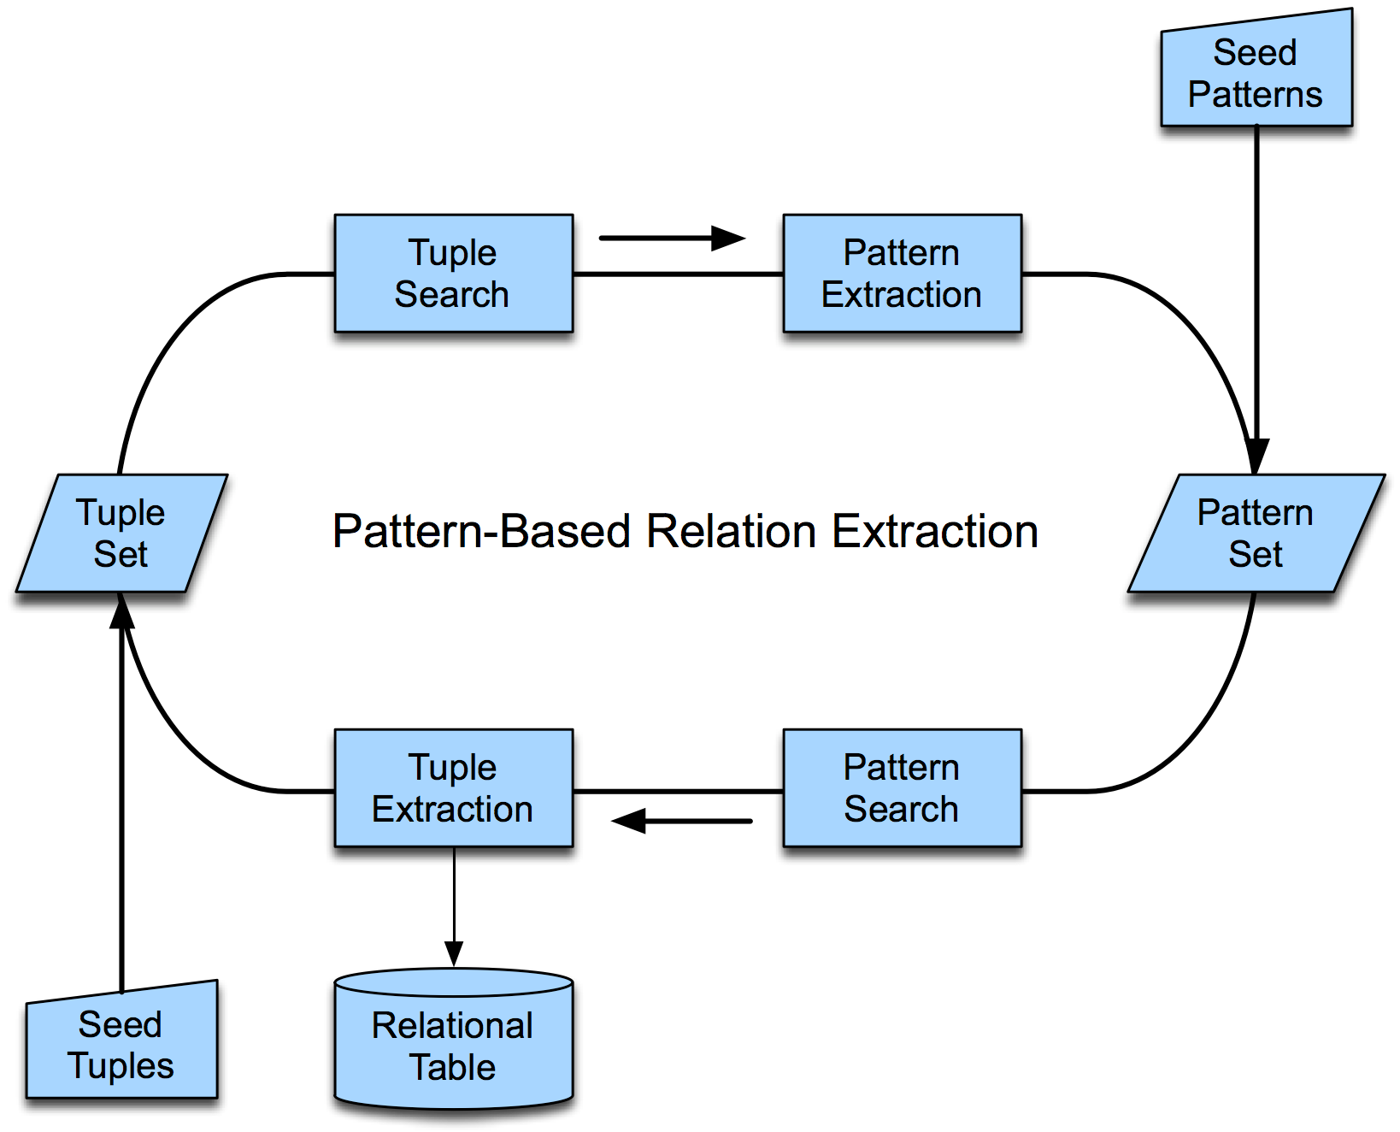
Bootstrapping Relations

Slide 37
Template Filling
For stories/texts with stereotypical sequences of events, participants, props, etc.
Represent these facts as slots and slot-fillers: templates (frames, scripts, schemas)
­ Evoke the right template
­ Identify the story elements that fill each slot
Similar approaches as to relation extraction, except that you also have the option of developing patterns or classifiers for more than one slot at once

Slide 38
Airline Example
Example template for “Attempt to raise fares,” with slots filled in from text
FARE-RAISE ATTEMPT: LEAD AIRLINE : UNITED AIRLINES
AMOUNT : $6 EFFECTIVE DATE : 2006–10–26
FOLLOWER : AMERICAN AIRLINES

Slide 39
Text Analysis Conference (TAC)
NIST is sponsoring these yearly text-analysis tasks (tracks) in the same spirit as TREC for information retrieval (IR)
Knowledge-based population (KBP)
­ Also tracks on textual entailment and summarization
Participants must process news articles and prepare an information-extraction template formatted as a Wikipedia infobox
­ Must also resolve entities across documents
­ In 2010, must also detect “certainty” of information
­ http://www.nist.gov/tac/

Slide 40
IE Example: Bioinformatic NLP

Slide 41
Bioinformatic NLP
So far, we have been looking at newswire text with fairly standard names and relations.
­ But names and relations in other domains may be very different
An example domain is bioinformatics.
­ Very important
­ Practitioners care about the technology
­ They have problems they’re trying to solve
­ A lot of text available
­ A lot of interesting problems
­ Domain examples from Jim Martin
2

Slide 42
A Lot of Text
Medline Growth Rate
18E + 6
15,072,561
14,451,219
13,889,085
13,352,989
12,829,574
12,314,270
11,838,481
11,381,409
10,940,964
10,498,293
10,065,801
9,644,153
9,232,699
8,829,228
8,428,636
8,030,245
7,639,126
7,263,975
6,907,212
new
total
16E + 6
14E + 6
12E + 6
10E + 6
8E + 6
6E + 6
4E + 6
2E + 6
00E +0
Medline Entries
621,342
562,134
536,096
523,415
515,304
475,789
457,072
440,445
442,671
432,492
421,648
411,454
403,471
400,592
398,391
391,119
375,151
356,763
338,819
2004
2003
2002
2001
2000
1999
1998
1997
1996
1995
1994
1993
1992
1991
1990
1989
1988
1987
1986
Year
3

Slide 43
Problem Areas
Mainly variants of NER and relation analysis
­ NER
­ Detecting and classifying named entities
­ And also normalization
­ Mapping that named entity to a particular entity in some external database or ontology
­ Medical field has external databases, or ontologies (e.g., UMLS for standard forms of named entities)
­ Relation analysis
­ How various biological entities interact
4

Slide 44
Bio-NER
Large number of fairly specific types
Wide (really wide) variation in the naming of entities
­ Gene names
­ White, insulin, BRCA1, breast cancer associated 1, ether a go-go, etc.
Semantic Class | Examples
Cell lines | T98G, HeLa cell, Chinese hamster ovary cells, CHO cells
Cell types | primary T lymphocytes, natural killer cells, NK cells
Chemicals | citric acid, 1,2- diiodopentane, C
Drugs | cyclosporin A, CDDP
Genes/proteins | white, HSP60, protein kinase C, L23A
Malignancies | carcinoma, breast neoplasms
Medical/clinical concepts | amyotrophic lateralsclerosis
Mouse strains | LAFT, AKR
Mutations | C10T, Ala64 Gly
Populations | judo group
5

Slide 45
Biorelations
Combination of IE- and SRL-style relation analysis
(22.27) [_{THEME} Full-length cPLA2] was [_{TARGET} phosphorylated] stoichiometrically by [_{AGENT} p42 mitogen-activated protein (MAP) kinase ] in vitro… and the major site of phosphorylation was identified by amino acid sequencing as [_{SITE} Ser505]
6

Slide 46
Bioinformatic IE
Much work in NLP is concerned with portability and generality.
­ How can we get systems trained on one genre/domain to work on a different one?
Biologists don’t seem to care much about this.
­ They’re happy if you build a specific system to solve their specific problem.
7

Slide 47
Exercise 9.1.5
Named Entity Types & Relations Exercise
Download the following file from BB located in Lectures - Week 9:
plane_news_article.doc
Give an example of each of the named entity types: person (PER), organization (ORG), location (LOC), geopolitical entity (GPE), facility (FAC), and vehicles (VEH), if there is one occurring in this article. You may wish to look at the Information Extraction lecture slides page 13 for category types and examples. Don’t forget that these must be named entities, so phrases like “the plane” don’t count.
Give examples of the relations:
Example(s) for a “Employed-by” relation between a named entity of type PER and one of type ORG. Give the PER and the ORG.
Example(s) for a “Located-in” relation between a named entity of type FAC and one of type LOC. Give the FAC and the LOC.
For relations, you may wish to look at examples from pages 21–22 in the Information Extraction lecture slides.
**Breakout Exercise**
Be prepared to share your results with the class.
8

Slide 48
Introduction to Machine Translation

Slide 49
Machine Translation (MT)
Translating text from one language to another is a challenging task, even for humans to try to fully capture the style and nuanced meaning of the original.
­ While research focuses on trying to produce the fully automatic, high- quality translation, there are many tasks for which a rough translation is sufficient.
­ The differences between languages include systematic differences that can be modeled in some way and idiosyncratic and lexical differences that must be dealt with one by one.
Machine translation focuses on:
­ Faithfulness: The meaning of the text has been preserved.
­ Fluency: The translated text sounds natural to a native speaker and also maintains the style of the original text.
2

Slide 50
Why MT Is Hard
Given the Japanese phrase:
­ fukaku hansei shite orimasu
If this is translated to English as:
­ we apologize, it is not faithful to the original meaning
But, if we translate it as:
­ we are deeply reflecting (on our past behavior, and what we did wrong, and how to avoid the problem next time), the translation is not fluent.
Example from Jurafsky and Martin text
3

Slide 51
Differences Between Languages
Morphological differences
­ Number of morphemes per word and sentence
­ Isolating languages: Vietnamese and Cantonese, each word has one morpheme
­ Polysynthetic languages: “Eskimo,” a single word has many morphemes corresponding to a complete sentence
­ Degree to which morphemes are segmentable
­ Agglutinative, morphemes have clean boundaries (Turkish)
­ Fusion languages, single affix may have multiple morphemes (Russian)
4

Slide 52
Differences Between Languages
Syntactic differences
­ Basic word order of verbs, subjects, and objects
­ SVO: English, Mandarin, French, German, …
­ SOV: Hindi, Japanese
­ VSO: Classical Arabic and Biblical Hebrew
­ Head-marking and dependent-marking languages
­ Mark relation between dependent and head on the head
­ English marks possessive on dependent: the man’s house
­ Hungarian marks possessive on the head noun (Hungarian equivalent of): the man house-his
5

Slide 53
Differences Between Languages
Syntactic differences
­ Direction of motion with respect to verb
­ English direction on particle: the bottle floated out
­ Spanish direction on verb: la botella salio’ flotando
­ Grammatical constraints on matching gender-marked words
­ Many others…
6

Slide 54
Differences Between Languages
Semantic differences
­ Lexical gap
­ One language doesn’t have a word for concept in another
­ Differences in way that conceptual space is divided up for different
words
paw
etape
animal paw
patte
animal leg
Journey leg
leg
bird foot
foot
human leg
chair leg
human foot
pied
jambe
The complex overlap between English leg, foot, etc. and various French translations.
(Jurafsky & Martin, Figure 21.2)
7

Slide 55
Machine Translation Task

Slide 56

Classical MT/Machine Translation
In this line of MT research, approaches can be classified according to the level of unit of translation.
­ Utilizes word translation dictionaries
­ Direct translation uses a word translation approach
­ Transfer approaches use syntactic phrase and semantic units as the unit of translation
Interlingua
Conceptual analysis
Conceptual generation
Semantic structure
Semantic transfer
Semantic structure
Shallow semantic analysis
Syntactic structure
Semantic generation
Syntactic transfer
Syntactic structure
Parsing
Syntactic generation
Words
Morphological analysis
Source language text
Direct
Words
Morphological generation
Target language text
Figure 25.3 The Vauquois triangle
2

Slide 57
Statistical Approaches
Build probabilistic models of faithfulness and fluency and combine the models to get the most probable translation
Modeled as a noisy channel
­ “Pretend that the foreign input F is a corrupted version of the target language output E and the task is to discover the hidden sentence E that generated the observed sentence F.”
­ Informally, we refer to translating from French to English.
3

Slide 58
Statistical Approaches
Requires two models
­ Language model to compute P(E), probability that any sequence E of English words is a sentence
­ Language model gives fluency
­ Translation model to compute P(F|E), conditional probability that French sentence F was a translation of English sentence E
­ Translation model gives faithfulness
­ Given French sentence f, its English translation e is arg max (all e in E) P(e) * P(f|e)
­ Note that this appears backwards to translate from French to English, but we invoke Bayes’ theorem to define the translator.
4

Slide 59
Language Models for Fluency
Language model to compute P(E), the probability that a sequence of words is in the language
This models fluency, how likely it is that an English language speaker would say this sentence
In practice, learn probabilities of bigrams in the language to be translated from instead of entire sentences
­ Translation has improved greatly due to large corpora
­ See Google Translate
5

Slide 60
Translation Models for Faithfulness
Translation model to compute P(F|E), the probability that the French sentence f came from the English sentence e
­ Learn probabilities from parallel corpora
­ Model the translation as word translation combined with alignment probabilities
­ E: And the program has been implemented.
­ F: Le programme a ete mis en application.
­ Alignment variables: (2, 3, 4, 5, 6, 6, 6) gives
Le | -> | the
Programme | -> | program
a | -> | has
ete | -> | been
mis | -> | implemented
en | -> | implemented
application | -> | implemented
6

Slide 61
Alignment and Parallel Corpora
The translation model uses probabilities of word alignment.
Word alignment models are automatically trained from parallel corpora where each document is given in two or more languages.
­ Hansard Corpus
­ Canadian parliament documents for French, English, and a variety of native American languages
­ United Nations proceedings documents
­ LDC (Linguistic Data Consortium) has corpora in several language pairs
Literary parallel corpora are not as suitable because of the stronger presence of literary devices, such as metaphor.
7

Slide 62
MT Evaluation
Human raters can evaluate along the two dimensions of fluency and fidelity (and there are several individual metrics for each of these dimensions)
BLEU automatic evaluation system
­ Evaluation corpus contains human-generated translations
­ Metrics evaluate how closely the system-generated translations correspond to the human ones
­ Measure the number of words and phrases overlapping between the human translation and the machine translation
8

Slide 63
Introduction to Summarization

Slide 64
Summarization
Text summarization is the process of distilling the most important information from a text to produce an abridged version for a particular task and user.
­ Definition adapted from Mani and Maybury, 1999
Types of summaries in current research
­ Outlines or abstracts of any document, article, etc.
­ Snippets summarizing a webpage or a search engine results page
­ Action items or other summaries of a business meeting
­ Summaries of email threads
­ Simplifying text by compressing sentences
­ Keyword extraction
2

Slide 65
Single vs. Multiple Documents
Single-document summarization
­ Given a single document, produce a gist of the content in the form of an abstract or outline
Multiple-document summarization
­ Given a group of documents, produce a gist of the content and create a cohesive answer that combines information from each document
­ A series of news stories on the same event
­ A set of webpages about some topic or question
3

Slide 66
Extractive vs. Abstractive
Abstractive summarization
­ Express the ideas in the source documents using (at least in part) different words
­ How humans typically approach summarization
Extractive summarization
­ Create the summary from phrases or sentences in the source document(s)
4

Slide 67
Example of Extractive Summary
Plane skids off snowy runway at New York’s LaGuardia airport
A plane skidded off the runway at LaGuardia airport in New York on Thursday, the latest example of travel woes plaguing the US from Texas to Connecticut as a major storm stretched across the country. The New York fire department reported 26 injuries and 3 hospitalizations, while the Port Authority of New York and New Jersey reported six.
“This particular runway had been plowed shortly before the incident and pilots on other planes reported good breaking conditions,” said Pat Foye, executive director of the Port Authority, which manages airport operations in New York. Not long before the plane’s landing, the Port Authority of New York and New Jersey reported “worsening” conditions in the area, reporting the closing of trucking at a shipping terminal in Newark, New Jersey.
This example summary is produced by an online demo site.
On the next slide, about half the news article is shown.
­ Summary does not paraphrase any sentences
­ Extracted sentences occur primarily near the beginning of the article
More generally, paraphrasing may be needed to correct dangling references.
­ Done from coreference resolution
5

Slide 68
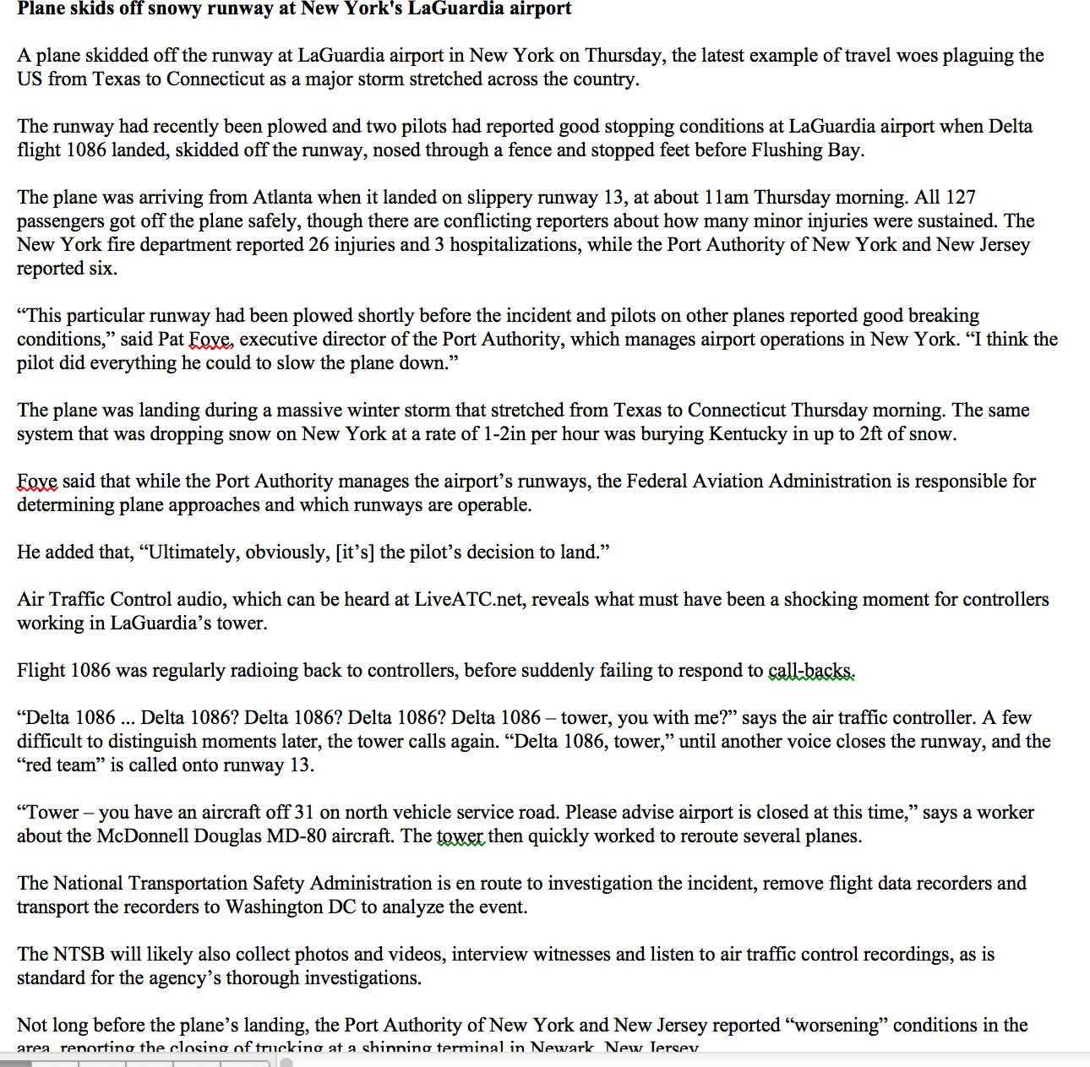
Example of Extractive Summary
Plane skids off snowy runway at New York’s LaGuardia airport
A plane skidded off the runway at LaGuardia airport in New York on Thursday, the latest example of travel woes plaguing the US from Texas to Connecticut as a major storm stretched across the country. The New York fire department reported 26 injuries and 3 hospitalizations, while the Port Authority of New York and New Jersey reported six.
“This particular runway had been plowed shortly before the incident and pilots on other planes reported good breaking conditions,” said Pat Foye, executive director of the Port Authority, which manages airport operations in New York. Not long before the plane’s landing, the Port Authority of New York and New Jersey reported “worsening” conditions in the area, reporting the closing of trucking at a shipping terminal in Newark, New Jersey.
6

Slide 69
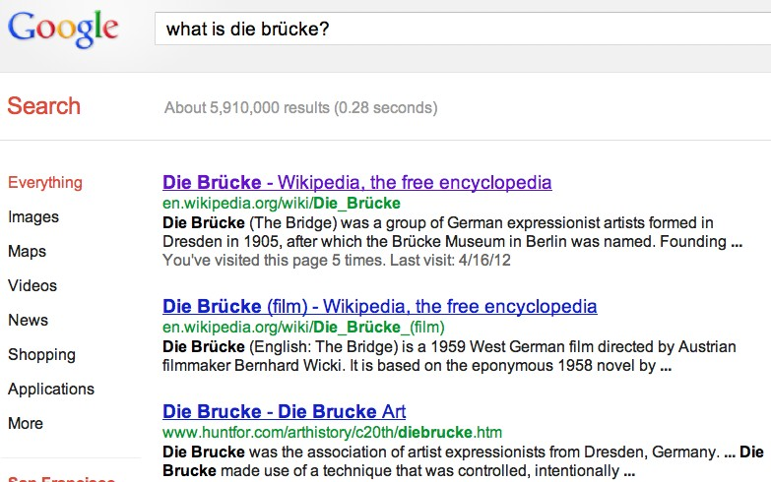
Summarization for Web Search: Snippets
Create snippets summarizing a webpage for a query.
­ Google: 156 characters (about 26 words) plus title and link
7

Slide 70
Summarization Task

Slide 71

Summarization Typical Approaches
Currently, achieve extraction instead of a true rephrasing.
­ Content selection
­ Identify the sentences or clauses to extract
­ Information ordering
­ How to order the selected units
­ Sentence realization
­ Perform cleanup on the extracted units so that they are fluent in their new context
­ Example: replacing pronoun or other references left dangling
All sentences from documents
Extracted sentences
Sentence realization
Sentence segmentation
Sentence extraction
Information ordering
Summary
Document
Sentence simplification
Content selection
2

Slide 72
Content Selection:
Centrality Methods
Centrality methods select sentences based on properties of words and sentences.
­ Don’t require annotated training data
­ But do draw on semantics of a background corpus
The simple approach is to select sentences that have more informative words according to saliency defined from a topic signature of the document.
­ Topics are learned from the larger corpus
­ A topic is a set of words grouped together that score high on relatedness, using mutual information or other semantic similarity
Centroid-based summarization uses log-likelihood ratios for words, computing the probability of observing the word in the input more often than in the background corpus.
3

Slide 73
Content Selection: TextRank
The TextRank or LexRank method scores the importance of sentences in a similar way to PageRank on webpages.
­ Each sentence is a vertex of a graph and the PageRank algorithm assigns scores based on the similarity of the words in the sentences.
­ The PageRank algorithm comes from search engines where pages are scored based on link structure.
­ TextRank also uses semantic similarity measures, which may be learned from the background corpus.
4

Slide 74
Content Selection: Other Methods
Methods based on rhetorical parsing use coherence relations to identify satellite and nucleus sentences.
Machine learning methods score sentences for importance from a corpus of sentences assigned importance scores.
­ Use features based on:
­ Position
­ Cue phrases
­ Word informativeness
­ Sentence length
­ Cohesion (computing lexical chains of the document)
5

Slide 75
Information Ordering
Single documents can simply keep the document ordering.
Chronological ordering for multiple documents
­ Order sentences by the date of the document (for summarizing news).
Coherence ordering
­ Choose orderings that make neighboring sentences similar.
­ Choose orderings in which neighboring sentences discuss the same entity.
Topical ordering
­ Learn the ordering of topics in the source documents.
6

Slide 76
Simplifying Sentences
Simplest method: Parse sentences and use rules to decide which modifiers to prune.
­ More recently, a wide variety of machine learning methods
Appositives | Rajam, 28, an artist who was living at the time in Philadelphia, found the inspiration in the back of city magazines.
Attribution clauses | Rebels agreed to talks with government officials, international observers said Tuesday.
Prepositional phrases without named entities | The commercial fishing restrictions in Washington will not be lifted unless the salmon population increases [PP to a sustainable number]]
Initial adverbials | “For example”, “On the other hand”, “As a matter of fact”, “At this point”
7

Slide 77
Summarization Evaluation
Extrinsic (task-based) evaluation: humans are asked to rate the summaries according to how well they are enabled to perform a specific task
Intrinsic (task-independent) evaluation
­ Human judgments to rate the summaries
­ ROUGE (recall oriented understudy gisting evaluation)
­ Humans generate summaries for a document collection.
­ System-generated summaries are rated according to how close they come to the human-generated summary.
­ Measures have included unigram overlap, bigram overlap, and longest common subsequence.
­ Pyramid method
­ Humans identify “units of meaning,” which are short phrases, and then an overlap measure is computed.
8

Slide 78
Lab Session – Week 9: More Features & Evaluation
Lab Homework
Download the Lab files located on BB in the folder: Lectures - Week 8.
labweek9bigramposeval.txt
lab1.bigramfeatures.doc
lab2.posfeatures.doc
lab3.crossvalidation.doc
lab4.evalmeasures.doc
For this lab session, use the file“labweek9bigramposeval.txt“ to copy/paste the Python examples as you try them out
Download the lab homework file: "Week 9 Lab Homework.docx" from BB (Lectures - Week 9). Complete Option A or Option B as described in the document.
Homework:
Submit a report summary that includes the baseline accuracy achieved with the one train/test split and the cross-validation accuracy with five-folds (and with ten folds if attempted). Include any observations and lessons learned in your report. In addition to the report summary, upload a copy of the python code you developed as part of this lab.

